Slide 1

Project : SQL Data Analysis and Visualization with Power BI for FDA

Slide 2
Project Description:
The U.S. Food and Drug Administration (FDA) is a federal agency responsible for safeguarding public health in the United States. It oversees various areas, including food safety, pharmaceuticals, medical devices, cosmetics, tobacco, and veterinary products. The FDA evaluates the safety and efficacy of drugs, biological products, and medical devices, conducts inspections, and enforces regulations. It also regulates food production and distribution, conducts research, provides public health education, and monitors and responds to emerging health risks. The FDA's mission is to protect and promote public health by ensuring the safety and effectiveness of a wide range of products and substances.

Slide 3
Agenda/project objective:
Part 1: SQL Queries.
Task 1: Identifying approval trends
Task 2: Segmentation Analysis Based on Drug Marketing Status
Task 3: Analyzing Products
Task 4: Exploring Therapeutic Classes and Approval Trends
Part 2: Power BI Visualizations
Question Details in Next Slide__
There are 2 part:
Part – 1 : SQL Queries.
Part – 2 : Power BI Visualizations.

Slide 4
Project Objective:
(i). Visualize the yearly approval trends of drugs. Highlight any significant patterns and/or fluctuations, if any.
(ii). Explore approval trends over the years based on different sponsors. Uncover patterns and changes in approval rates among sponsors.
(iii). Visualize the segmentation of products based on MarketingStatus.
(iv). Show the total number of applications for each MarketingStatus. Enable users to filter by years and MarketingStatus for detailed analysis.
(v). Analyze the grouping of drugs by dosage form. Visualize the distribution of approvals across different forms. Identify the most successful dosage form.
(vi). Visualize drug approvals based on therapeutic classes. Identify classes with the highest number of approvals.
Part 2: Power BI Visualizations:

Slide 5
Strategies for Writing queries in MySQL workbench:
Understand the database structure
Define the clear Objective
Optimize the query performance
Follow SQL best practices

Slide 6
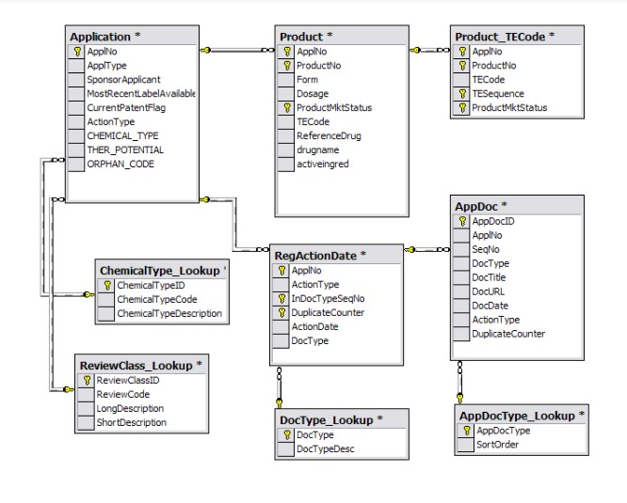
Understand the table connection based on eer diagram:

Slide 7
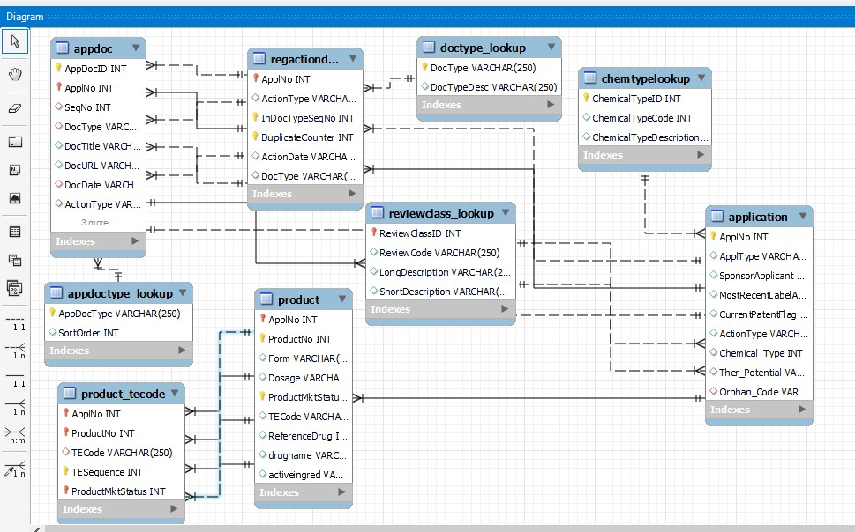
One more EER Diagram has created in MySQL Workbench for Analysis that how the tables connection works during writing queries.

Slide 8
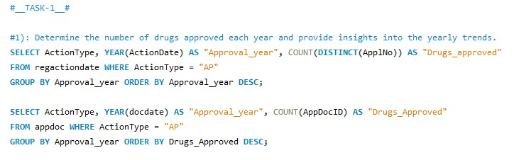
Achieving the project goals of Part 1: SQL Queries.
Task 1- Identifying Approval Trends.
1. Determine the number of drugs approved each year and provide insights into the yearly trends.
The very first step to do that we will have to create schema for the FDA data in which can run all the dataset which is provided by class .
Once dataset has been stored in the schema then will create tables and etc. related to the dataset and we can see the all tables created in the Schema.
Before Execution will have to connect the server which is the created already during installing the software. After Connect with server then execute first the Schema which name is fda_data in mine.
For execution of this query will have to select all the scripts first the click on execute button then got the Output of 1st question of task 1.

Slide 9
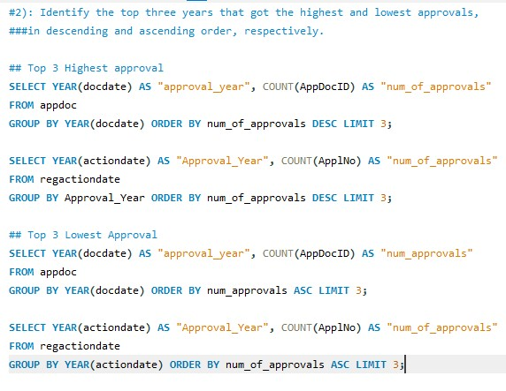
Task 1- Identifying Approval Trends.
2. Identify the top three years that got the highest and lowest approvals, in descending and ascending order, respectively.
For execution of this query will have to select all the scripts first the click on execute button then got the Output of 2nd question of task 1.

Slide 10
See all the scripts for all SQL queries.
Click the FDA project.sql OR SCRIPTS for sql project.txt which attached in this slide on left side. Just Double Tap on the text file OR sql file then see all scripts which is created by me.

Slide 11
Part – 2 Power BI Visualizations:
In visualization part we have six question for visualization
Before the visualizations we will have to connect MySQL Database in Power BI with the user name and password of MySQL Workbench. To get/load the all the tables with the Data in Power BI.
Once the tables load in Power BI then the data should be cleaning and filtering and changing in the type(Without change the type we can’t create the date in hierarchy) anything we can do for getting the cleaned data.
After the cleaning data, we can go for a modelling and needs to be manage the relationship among the tables in the most appropriate manner.

Slide 12
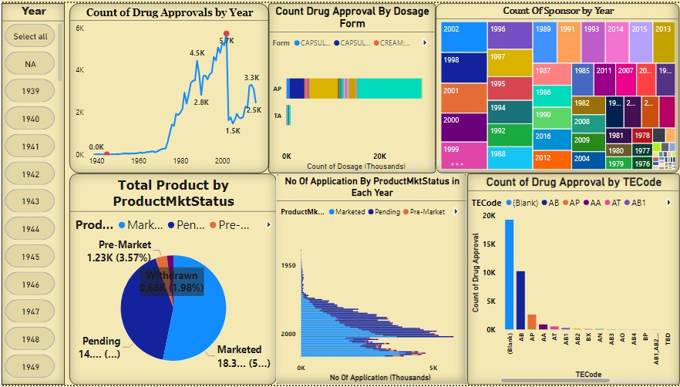
FDA DASHBOARD

Slide 13

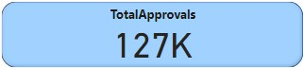
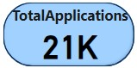
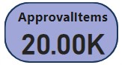
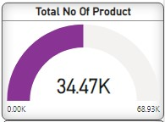
Some of the aggregate function with the value in insight this is the very helpful for calculate value of respect to something.
We get the value as Total approval, Total number of Application, Approval items and Total no of product with the Gauge Chart.

Slide 14
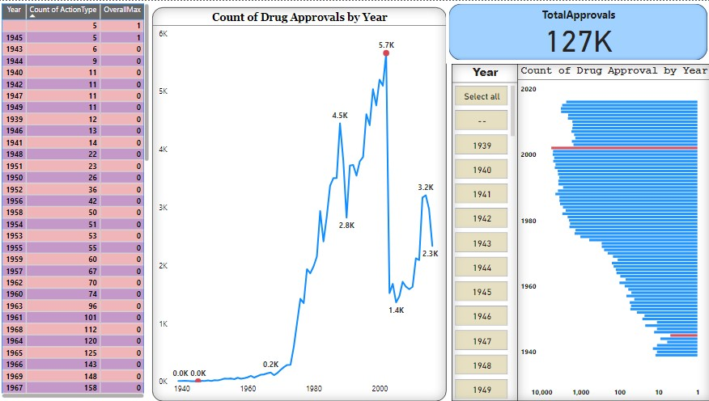
1st : Visualization
Visualize the yearly approval trends of drugs. Highlight any significant patterns and/or fluctuations, if any.
The yearly approval trends of drugs exhibit fluctuations, with certain years experiencing spikes in approvals while others show a decline.
By the line chart we can see the fluctuation in drug approval and highlight the highest/lowest approval by the years.
And we can see the Stacked Bar Chart in this chart also shows the value and highlight those value which is highest and lowest approval in red color.
We have the slicer for the year. By the year we can see the approvals.

Slide 15
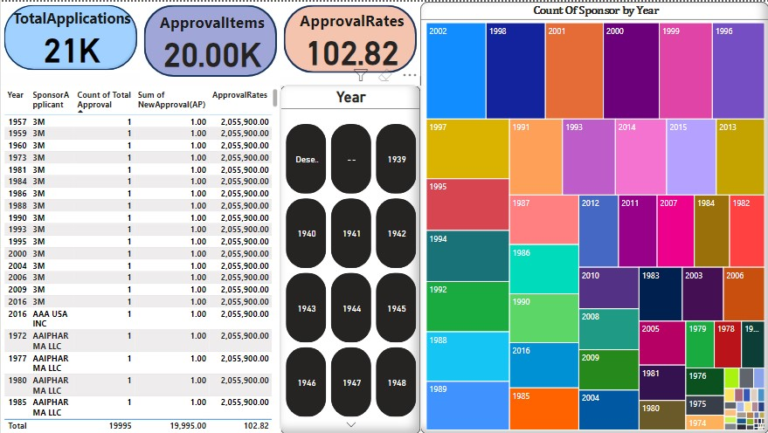
2nd : Visualization
Explore approval trends over the years based on different sponsors. Uncover patterns and changes in approval rates among sponsors.
We have examine approval trends over the years across various sponsors. By analyzing patterns and changes in approval rates among sponsors, we aim to uncover insights into their performance and influence over time. Here we can easily understand the count of approval in each year among the sponsor using the tree map chart. And analysis the value in the table view and using the slicer for getting the sponsor by the year.

Slide 16
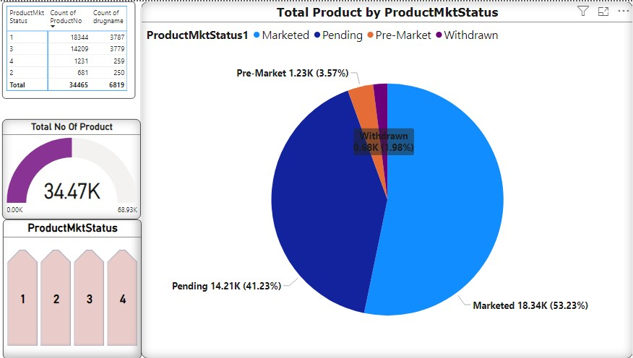
3rd : visualization
Visualize the segmentation of products based on Marketing Status.
We have create a visualization to showcase the segmentation of products based on their Marketing Status.
Here, Each segment of the chart represents a different marketing status category such as “1 for Marketed”, ”2 for Withdrawn”, ”3 for Pending”, ”4 for Pre-Market”.
And we have create a slicer for product marketing status which use we can easily get that which marketing status have how many products.

Slide 17
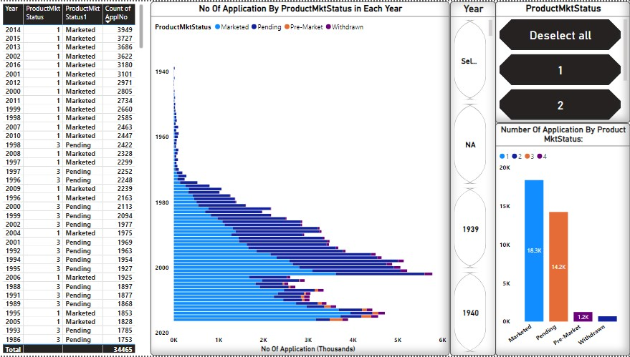
4th : Visualization
Show the total number of applications for each Marketing Status. Enable users to filter by years and Marketing Status for detailed analysis.
The data is presenting visually, making it easier to identify trends and patterns in application distribution across different Marketing Status categories.
We can use Slicer in the chart by selecting specific years and Marketing Status to focus on specific subsets of the data.

Slide 18
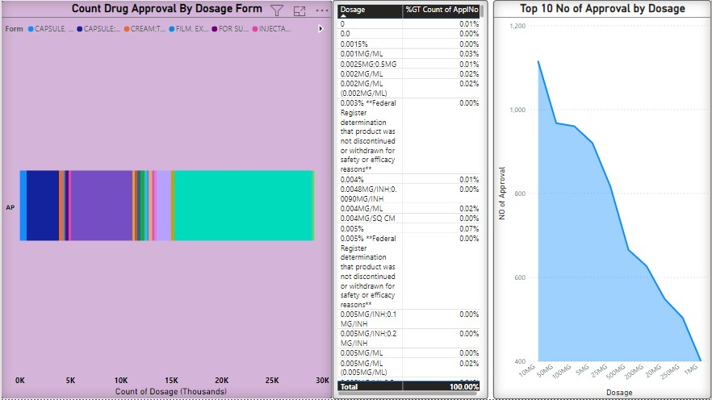
5th : visualization
Analyze the grouping of drugs by dosage form. Visualize the distribution of approvals across different forms. Identify the most successful dosage form.
The bar chart visualization showcases the distribution of approvals across different dosage forms, with oral tablets dominating the market with the highest number of approvals. Following oral tablets, capsules and injectables show significant approval count as well.
And also getting the top 10 number of approval by dosage in Area chart visualization, count of drug approval by dosage form in the Stacked bar Chart.

Slide 19
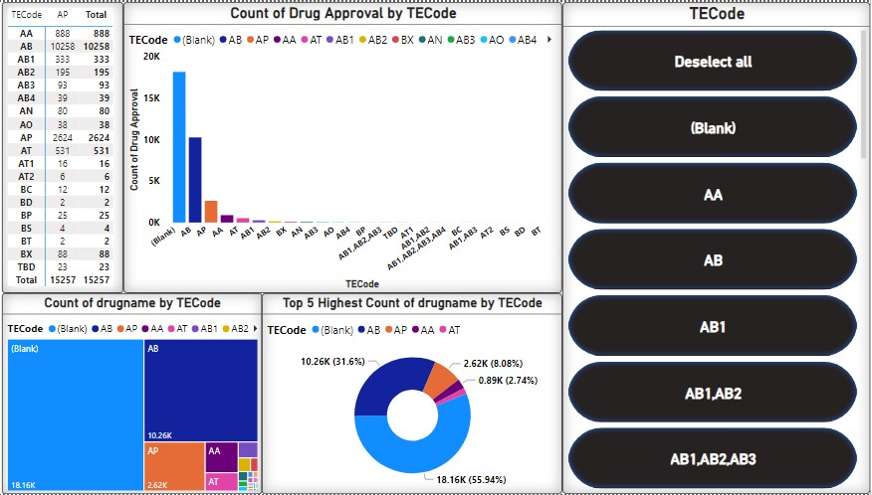
6th : Visualization
Visualize drug approvals based on therapeutic classes. Identify classes with the highest number of approvals.
In this visualization each bar represents a therapeutic code and its height corresponds to the number of approvals within that codes.
All the chart sorted in descending order to highlight the classes with the highest number of approvals at the top. And it separated by each colors.
TECode represented as a Slicer which helps in each codes have what's the approval value.

Slide 20

Thank you
Atul Prajapati / user.atul@yahoo.com

